Slide 1
Detección de Ciberamenazas
IFATSEA CUN2025

Slide 2

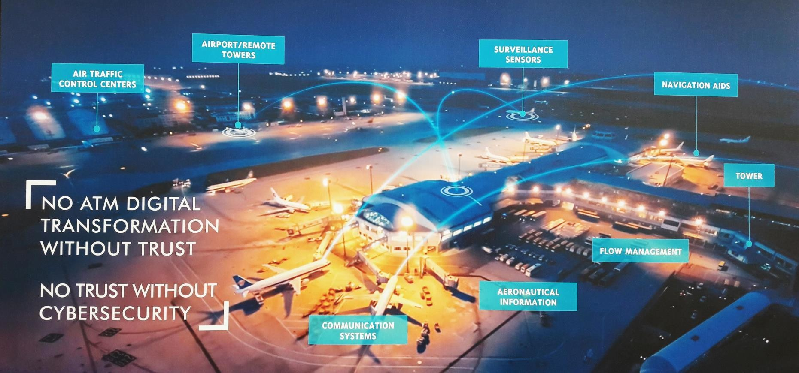





Transformación Digital
Integración de sistemas de IT y OT
Interconexión de los sistemas digitales
Incrementa la superficie de ataque
Los sistemas de ATM modernos se basan en el intercambio de datos entre:
  ANSP, aeronaves, satélites y torres de control
Cada interfaz digital es un punto de entrada potencial para los ciber atacantes
Los sistemas de tecnología operativa (OT) se fusionan ahora con las redes informáticas modernas, lo que introduce vulnerabilidades
Transición de sistemas aislados interconectados en comunicación, navegación y vigilancia
Permite la eficiencia pero aumenta la exposición

Slide 3



Con base a la experiencia de Thales, los proveedores de servicios de navegación aérea (ANSP) y las autoridades competentes de aviación (CAA) se enfrentan a diferentes desafíos cibernéticos.
1
2
3
Tres desafíos principales, pero cada ANSP/CAA
ATAQUES SE ESTÁN INCREMETNADO
  x20 en 2023
  Interrupciones operativas (45%) + impactos reputacionales (6%)
  30% de probabilidad de incidente
CRECIENTE NORMATIVA CIBERNÉTICA
  ¿De aviación? ¿ICAO?
  ¿De IT? ¿NIST?, ¿ISO27k?
  ¿Nacionales?
LOS SISTEMAS DE SERVICIOS DE NAVEGACIÓN AÉREA ESTÁN EN RIESGO
  Históricamente con bajas características de ciberseguridad
  Falta de habilidades en ciberseguridad/presupuesto
  Confidencialidad y protección de datos
  Nuevas soluciones basadas en la nube
Notes:
From our experience, ANSP are facing those 3 main challenges when they have to adress cyber topics and day to day work.
First, attacks are increasing in the global aviation community. Eurocontrol report notices it.
Second, cyber regulation are strenghtening
Third, the solution that we have on the field for the Air Navigation Service are used to have low cyber features (concept of cyber by design is quite new). Complicated to find new people with the good cyber skills.
In chapter 2, we will see that we are adressing those challenges within thales
***
The Hidden Threat in the Skies | Cyentia Institute

Slide 4


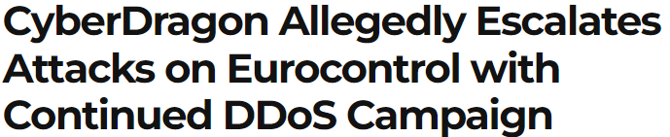


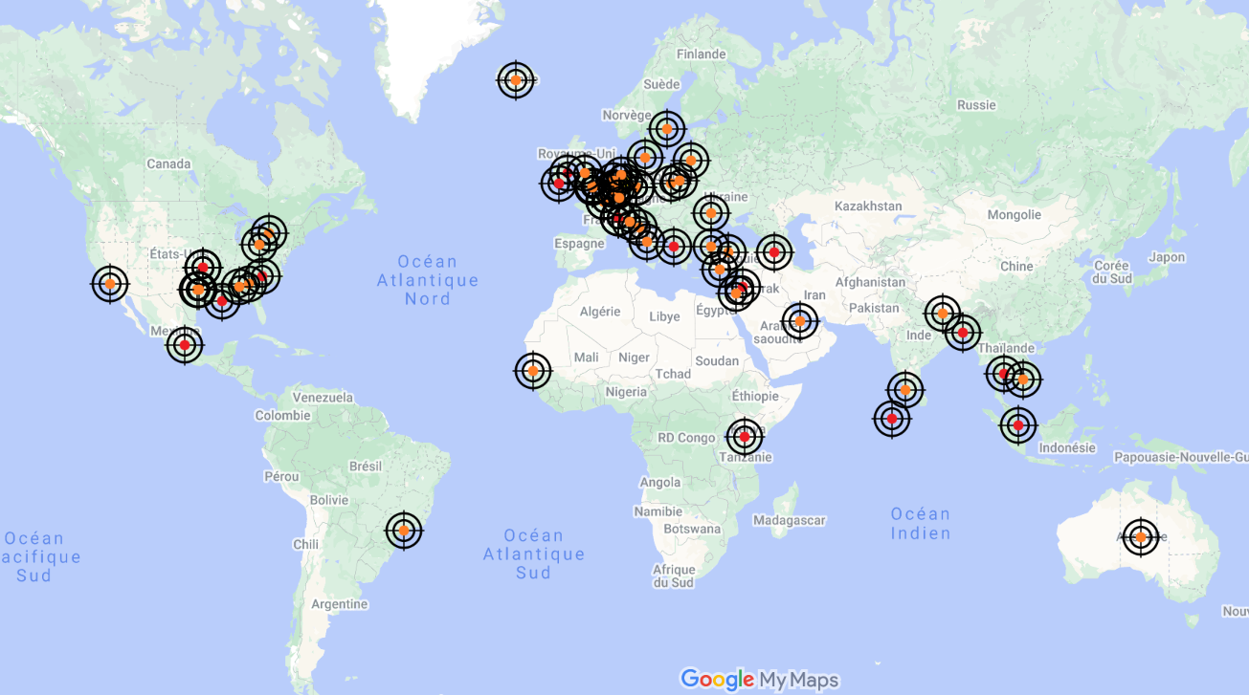

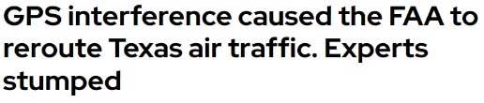
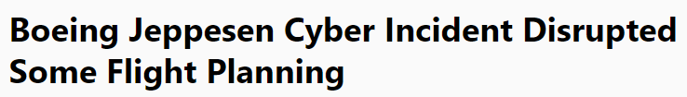
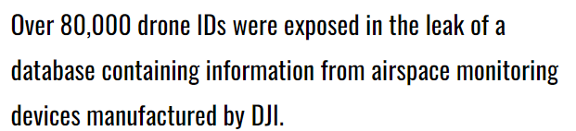
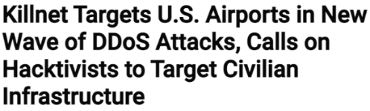




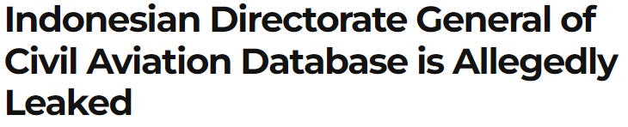
INCREMENTANDO LOS ATAQUES
EUROCONTROL EATM-CERT report 2024:
Los incidentes de ciberseguridad en la aviación están aumentando (x20 para ANSP)
Las principales motivaciones son las ganancias financieras (cyber criminales) con billones de € en pérdidas anuales e ideologicas (negación de servicio por activistas)
Interrupciones operativas y de servicio del ANSP (45%) + impactos reputacionales (6%). 48% de los incidentes son altos o críticos
Notes:
Quick deep dive into those 3 challenges.
Here are few news reported about attacks in the global aviation ecosystem : very different type of attacks which are targeting this ecosystem: from GPS interference causing traffic management disruption, to ransomware attack that corrupt all ANSP information, to data leaks of sensitive data on the Cloud…). Even Thales is targeted by famous LockBit ransomware group.
What we can see from that also reported into the Eurocontrol annual cyber incident report, is that the number of incident are raising in aviation. One of the reason is the motivation of attackers to have financial gains + hacktivist for denial of service and reputation.
+ read the blue box (insider, supply chain attacks, Operational disruption have to be highlighted)
EUROCONTROL EATM-CERT report 2024:
6 320 in 2023 (compared to 2732 in 2022, 2165 in 2021 and 1260 in 2020).
Most of attacks in aviation are on Airspace users (60%) using are fraudulent website for financial gains. 7 critical events, none safety.
ANSP cyber incidents reported in 2023 reached 1 025 (x20 in a year). CAA to 88 (x3) ➔ huge increase + Airports and ANSP are facing similar numbers of cyber attacks
ANSP has a unique profile of cyber victim: ransomware and hacktivists are less interested than other aviation stakeholders. But 45% of known cyber attacks impacts are leading to Service and Operational disruptions, 6% to Reputational. 48 incidents were classified as High or Critical severity. Systems and networks assets are targeted. 2 Supply Chain compromise were reported by ANSP.
CAA threats are balanced among 4 different motivations + low security awareness (password management)
Press releases:
Malaysia/Thales: Thales: Lockbit releases stolen data, company denies any intrusion into its IT systems
Philippines: CAAP rules out cyber attack on NAIA technical glitch, reiterates need for upgrade

Slide 5
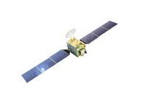



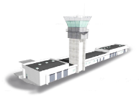





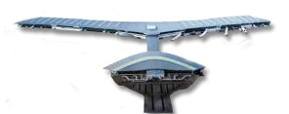




Amenazas en el sector aeronáutico
Inserción de una USB infectada en un
sistema ATC en linea
Controlador o Piloto usurpación sobre
Datalink
Usurpación de inicio de sesión en la posición técnica del sistema ATC
Inyección de malware
Airport Tower
ATC
Intrusión remota en ATC LAN
Approach ATC
En-route ATC
Spoofing del GPS de time
Network & Airspace Management
Suplantación de la señal de radio ADS-B
Surveillance & Navigation
infrastructure
Denegación de servicio en el servidor de información aeronáutica
Airport Operation Center
Aeronautical Information Providers
Suplantación de datos de radar en la red de interconexión
Airline Operational Centre
Inyección de malware en la cadena de suministro
Supplier
Notes:
Quick deep dive into those 3 challenges.
Here are few news reported about attacks in the global aviation ecosystem : very different type of attacks which are targeting this ecosystem: from GPS interference causing traffic management disruption, to ransomware attack that corrupt all ANSP information, to data leaks of sensitive data on the Cloud…). Even Thales is targeted by famous LockBit ransomware group.
What we can see from that also reported into the Eurocontrol annual cyber incident report, is that the number of incident are raising in aviation. One of the reason is the motivation of attackers to have financial gains + hacktivist for denial of service and reputation.
+ read the blue box (insider, supply chain attacks, Operational disruption have to be highlighted)
EUROCONTROL EATM-CERT report 2024:
6 320 in 2023 (compared to 2732 in 2022, 2165 in 2021 and 1260 in 2020).
Most of attacks in aviation are on Airspace users (60%) using are fraudulent website for financial gains. 7 critical events, none safety.
ANSP cyber incidents reported in 2023 reached 1 025 (x20 in a year). CAA to 88 (x3) ➔ huge increase + Airports and ANSP are facing similar numbers of cyber attacks
ANSP has a unique profile of cyber victim: ransomware and hacktivists are less interested than other aviation stakeholders. But 45% of known cyber attacks impacts are leading to Service and Operational disruptions, 6% to Reputational. 48 incidents were classified as High or Critical severity. Systems and networks assets are targeted. 2 Supply Chain compromise were reported by ANSP.
CAA threats are balanced among 4 different motivations + low security awareness (password management)
Press releases:
Malaysia/Thales: Thales: Lockbit releases stolen data, company denies any intrusion into its IT systems
Philippines: CAAP rules out cyber attack on NAIA technical glitch, reiterates need for upgrade

Slide 6





Que es la ciberdetección?
Identificar actividades anómalas
Identificar vulenrabilidades en sistemas
Identificar ataques cibernéticos
En tiempo real o casi real

Slide 7





Como conseguir la Ciber Detección
HERRAMIENTAS DE SEGURIDAD
ANÁLSIS DE COMPORTAMIENTO
SIEM
IDS
EDR
Monitoreo de comportamiento
CSOC (Cyber Security Operation Center)
INTELIGENCIA CONTRA AMENAZAS
AUDITORIAS Y EVALUACIONES DE SEGRUIDAD
Información sobre amenazas
ciberneticas
Auditorias periódicas y análisis de vulnerabilidades
FORMACIÓN Y COSIENTACIÓN DEL PERSONAL
Capacitación al personal para reconocimiento de activiaddes sospechosas

Slide 8
Consecuencias de tener una solución de Ciber Detección
Incremento en el Riesgo de Ataques
Datos sensibles en Riesgo
Dificultad en la identificación de incidentes de seguridad
Enfoque Reactivo y No Proactivo
Costos Elevados de Recuperación
Notes:
FAIRE UNE ID CARD SOUVERAINETE / THALES A SOVEREIGN PARTNER IN CYBER - CREDENTIALS (ANSSI & COMCYBER PARTNER, COM CYBER PARTNER, ERCOM PRESIDENT, PRODUITS CERTIFIES, NATO CRYPTO NORVEGE, PROJETS NATO ? CERTIFS EU, GALILEO EUROCONTROL, WORKING GROUPS TYPE ECSO, WALES/OMAN/DUBAI, CRYPTOLAB, KEY MANAGEMENT,

Slide 9
Respuesta de THALES

Slide 10



Thales ofrece:
Servicios
Detectar
y Responder
Productos
Soluciones

Slide 11
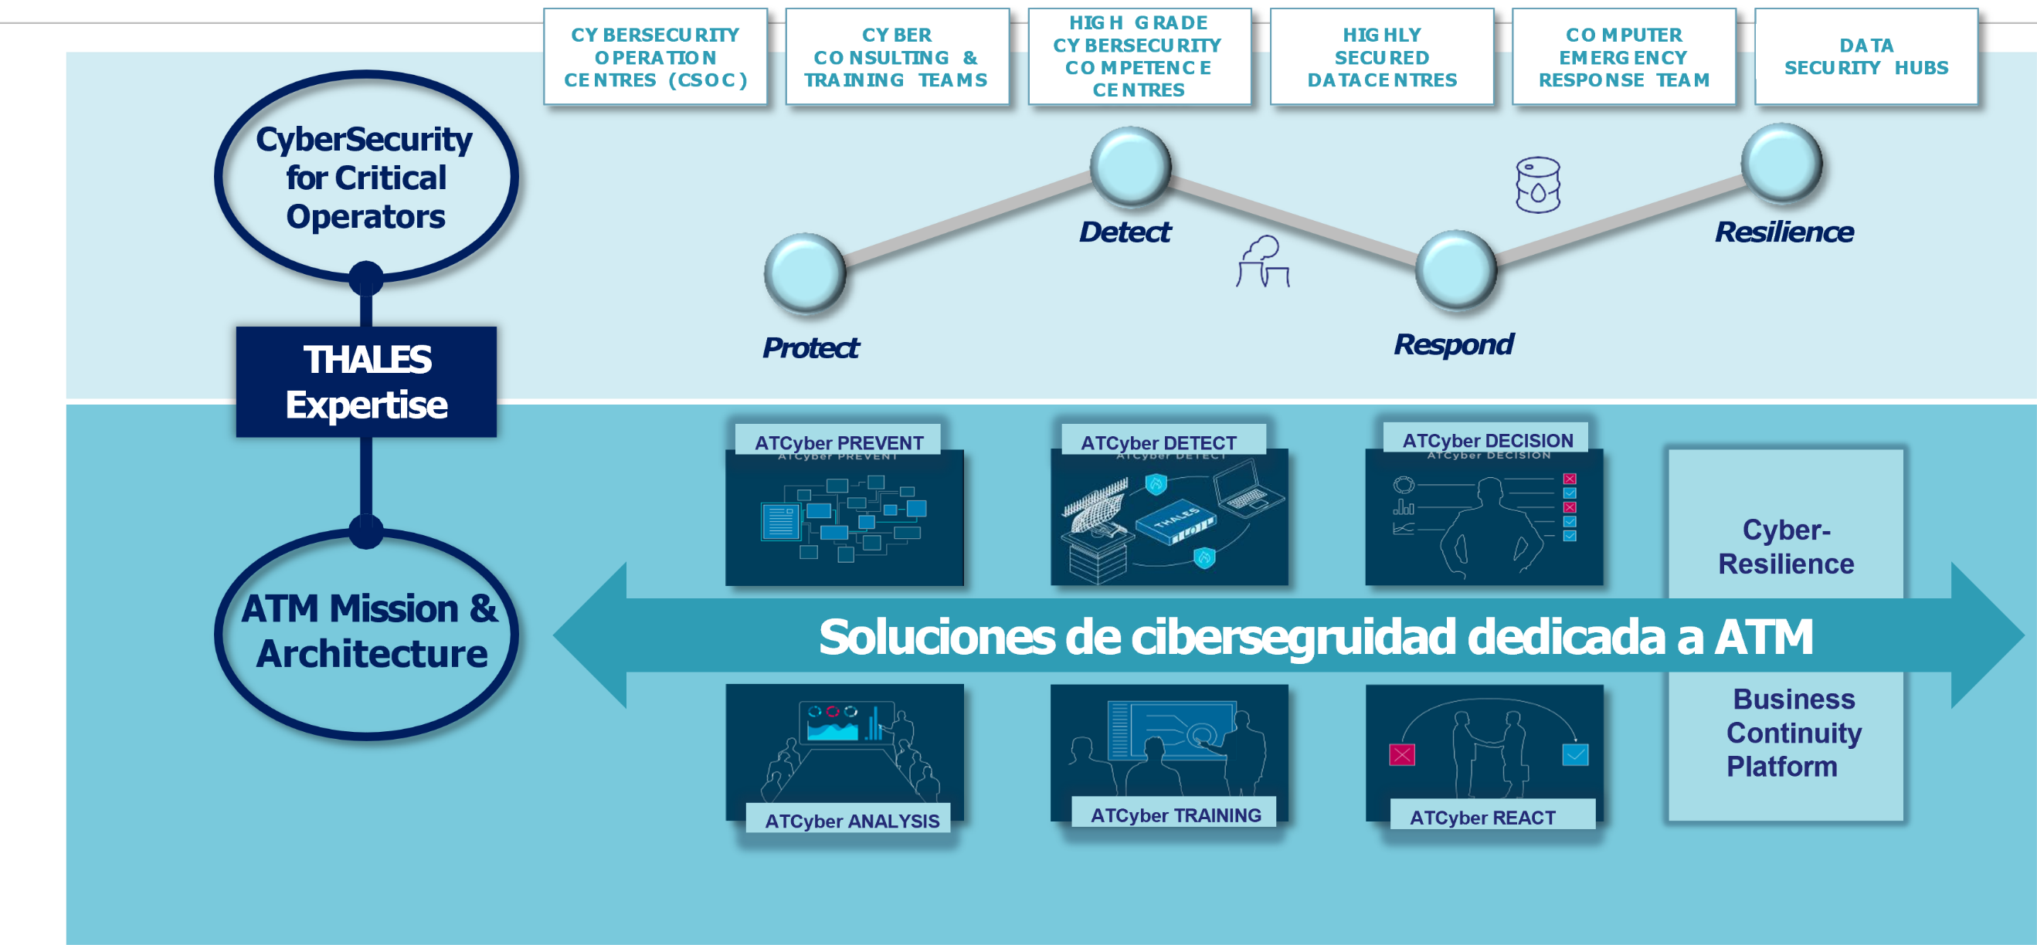




























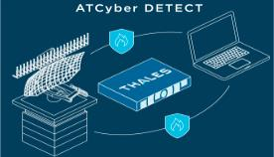
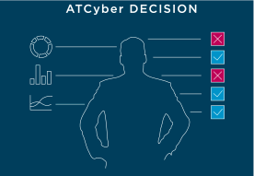








Descripción general de los productos Cybels para Detectar y Responder
CY B E R S E CU R I T Y
O P E R A T I O N
CE N T R E S ( CS O C )
CY B E R
CO N S U L T I N G & T R A I N I N G T E A M S
H I G H G R A D E
H I G H L Y
S E CU R E D
D A T A CE N T R E S
CO M P U T E R
E M E R G E N CY
R E S P O N S E T E A M
D A T A
S E CU R I T Y H U B S
CY B E R S E CU R I T Y
CO M P E T E N C E CE N T R E S
CyberSecurity for Critical Operators
Detect
Resilience
THALES
Protect
Respond
Expertise
ATCyber PREVENT
ATCyber DETECT
ATCyber DECISION
Cyber-
Resilience
ATM Mission & Architecture
Soluciones de cibersegruidad dedicada a ATM
Business Continuity Platform
Se necesita más preparación
ATCyber ANALYSIS
ATCyber TRAINING
ATCyber REACT
Notes:
Quick deep dive into those 3 challenges.
Here are few news reported about attacks in the global aviation ecosystem : very different type of attacks which are targeting this ecosystem: from GPS interference causing traffic management disruption, to ransomware attack that corrupt all ANSP information, to data leaks of sensitive data on the Cloud…). Even Thales is targeted by famous LockBit ransomware group.
What we can see from that also reported into the Eurocontrol annual cyber incident report, is that the number of incident are raising in aviation. One of the reason is the motivation of attackers to have financial gains + hacktivist for denial of service and reputation.
+ read the blue box (insider, supply chain attacks, Operational disruption have to be highlighted)
EUROCONTROL EATM-CERT report 2024:
6 320 in 2023 (compared to 2732 in 2022, 2165 in 2021 and 1260 in 2020).
Most of attacks in aviation are on Airspace users (60%) using are fraudulent website for financial gains. 7 critical events, none safety.
ANSP cyber incidents reported in 2023 reached 1 025 (x20 in a year). CAA to 88 (x3) ➔ huge increase + Airports and ANSP are facing similar numbers of cyber attacks
ANSP has a unique profile of cyber victim: ransomware and hacktivists are less interested than other aviation stakeholders. But 45% of known cyber attacks impacts are leading to Service and Operational disruptions, 6% to Reputational. 48 incidents were classified as High or Critical severity. Systems and networks assets are targeted. 2 Supply Chain compromise were reported by ANSP.
CAA threats are balanced among 4 different motivations + low security awareness (password management)
Press releases:
Malaysia/Thales: Thales: Lockbit releases stolen data, company denies any intrusion into its IT systems
Philippines: CAAP rules out cyber attack on NAIA technical glitch, reiterates need for upgrade

Slide 12

Productos – Cybels Sensor
Monitoreo de constante de posibles ataques
Análisis de comportamiento
Detección de amenazas – reglas de detección con algoritmos de análisis de Thales
Acreditado por la Agencia de Segurida Nancional de Francia (ANSSI)
Centros de Control Aéreo
Sistema de radar y Comunicaciones
Redes de navegación satelital
Infraestructura en tierra y aeronaves interconectadas
Provedore se servicios de navegación aérea (ANSP)

Slide 13

Servicio – Cybels
Intelligence
Recopila información sobre amenazas
Proporciona inteligencia:
  Tácticas, técnicas y procediminetos
  Indicadores de compromise (IoC)
  Detalles contextuales de los adversaries acorde al sector ATM
Alimentación de información de fuentes externas y de Thales
Integración con otras soluciones de cibersegruidad

Slide 14
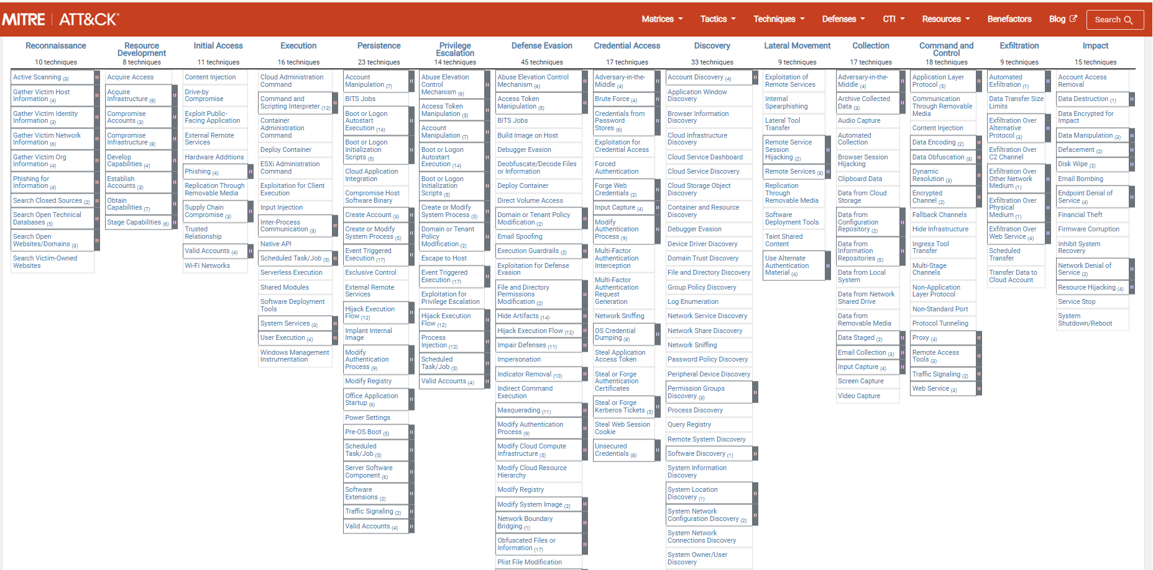

TTP (Técnicas, tácticas y procedimientos)
Notes:
Quick deep dive into those 3 challenges.
Here are few news reported about attacks in the global aviation ecosystem : very different type of attacks which are targeting this ecosystem: from GPS interference causing traffic management disruption, to ransomware attack that corrupt all ANSP information, to data leaks of sensitive data on the Cloud…). Even Thales is targeted by famous LockBit ransomware group.
What we can see from that also reported into the Eurocontrol annual cyber incident report, is that the number of incident are raising in aviation. One of the reason is the motivation of attackers to have financial gains + hacktivist for denial of service and reputation.
+ read the blue box (insider, supply chain attacks, Operational disruption have to be highlighted)
EUROCONTROL EATM-CERT report 2024:
6 320 in 2023 (compared to 2732 in 2022, 2165 in 2021 and 1260 in 2020).
Most of attacks in aviation are on Airspace users (60%) using are fraudulent website for financial gains. 7 critical events, none safety.
ANSP cyber incidents reported in 2023 reached 1 025 (x20 in a year). CAA to 88 (x3) ➔ huge increase + Airports and ANSP are facing similar numbers of cyber attacks
ANSP has a unique profile of cyber victim: ransomware and hacktivists are less interested than other aviation stakeholders. But 45% of known cyber attacks impacts are leading to Service and Operational disruptions, 6% to Reputational. 48 incidents were classified as High or Critical severity. Systems and networks assets are targeted. 2 Supply Chain compromise were reported by ANSP.
CAA threats are balanced among 4 different motivations + low security awareness (password management)
Press releases:
Malaysia/Thales: Thales: Lockbit releases stolen data, company denies any intrusion into its IT systems
Philippines: CAAP rules out cyber attack on NAIA technical glitch, reiterates need for upgrade

Slide 15
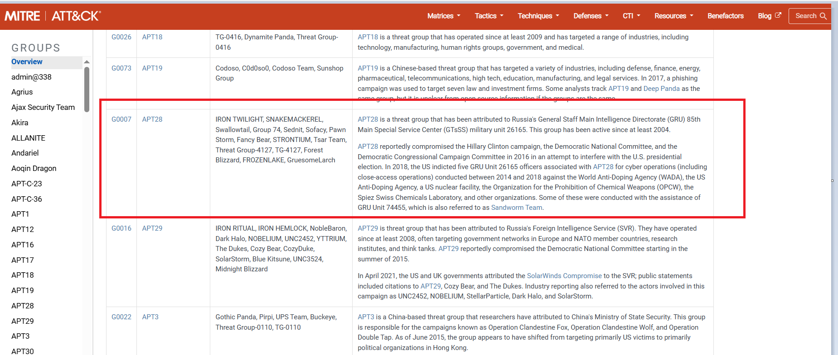
Grupos APT
Notes:
Quick deep dive into those 3 challenges.
Here are few news reported about attacks in the global aviation ecosystem : very different type of attacks which are targeting this ecosystem: from GPS interference causing traffic management disruption, to ransomware attack that corrupt all ANSP information, to data leaks of sensitive data on the Cloud…). Even Thales is targeted by famous LockBit ransomware group.
What we can see from that also reported into the Eurocontrol annual cyber incident report, is that the number of incident are raising in aviation. One of the reason is the motivation of attackers to have financial gains + hacktivist for denial of service and reputation.
+ read the blue box (insider, supply chain attacks, Operational disruption have to be highlighted)
EUROCONTROL EATM-CERT report 2024:
6 320 in 2023 (compared to 2732 in 2022, 2165 in 2021 and 1260 in 2020).
Most of attacks in aviation are on Airspace users (60%) using are fraudulent website for financial gains. 7 critical events, none safety.
ANSP cyber incidents reported in 2023 reached 1 025 (x20 in a year). CAA to 88 (x3) ➔ huge increase + Airports and ANSP are facing similar numbers of cyber attacks
ANSP has a unique profile of cyber victim: ransomware and hacktivists are less interested than other aviation stakeholders. But 45% of known cyber attacks impacts are leading to Service and Operational disruptions, 6% to Reputational. 48 incidents were classified as High or Critical severity. Systems and networks assets are targeted. 2 Supply Chain compromise were reported by ANSP.
CAA threats are balanced among 4 different motivations + low security awareness (password management)
Press releases:
Malaysia/Thales: Thales: Lockbit releases stolen data, company denies any intrusion into its IT systems
Philippines: CAAP rules out cyber attack on NAIA technical glitch, reiterates need for upgrade

Slide 16
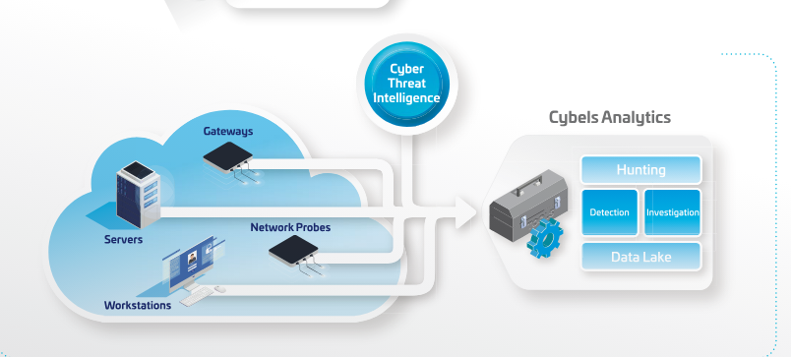
Servicio – Cybels
Analytics
Recopila eventos de mutiples productos de seguridad (Cybels Sensor)
Integración de con Plataforma Cyber Threat Intelligence) para la detección
de amenazas conocidas
Rápida identificación de amenazas
Busqueda proactiva de amenazas (hunting)

Slide 17

Notes:
Quick deep dive into those 3 challenges.
Here are few news reported about attacks in the global aviation ecosystem : very different type of attacks which are targeting this ecosystem: from GPS interference causing traffic management disruption, to ransomware attack that corrupt all ANSP information, to data leaks of sensitive data on the Cloud…). Even Thales is targeted by famous LockBit ransomware group.
What we can see from that also reported into the Eurocontrol annual cyber incident report, is that the number of incident are raising in aviation. One of the reason is the motivation of attackers to have financial gains + hacktivist for denial of service and reputation.
+ read the blue box (insider, supply chain attacks, Operational disruption have to be highlighted)
EUROCONTROL EATM-CERT report 2024:
6 320 in 2023 (compared to 2732 in 2022, 2165 in 2021 and 1260 in 2020).
Most of attacks in aviation are on Airspace users (60%) using are fraudulent website for financial gains. 7 critical events, none safety.
ANSP cyber incidents reported in 2023 reached 1 025 (x20 in a year). CAA to 88 (x3) ➔ huge increase + Airports and ANSP are facing similar numbers of cyber attacks
ANSP has a unique profile of cyber victim: ransomware and hacktivists are less interested than other aviation stakeholders. But 45% of known cyber attacks impacts are leading to Service and Operational disruptions, 6% to Reputational. 48 incidents were classified as High or Critical severity. Systems and networks assets are targeted. 2 Supply Chain compromise were reported by ANSP.
CAA threats are balanced among 4 different motivations + low security awareness (password management)
Press releases:
Malaysia/Thales: Thales: Lockbit releases stolen data, company denies any intrusion into its IT systems
Philippines: CAAP rules out cyber attack on NAIA technical glitch, reiterates need for upgrade

Slide 18




Stay connected with us
Hugo Espino
israel.espino@thalesgroup.com
Notes:
Quick deep dive into those 3 challenges.
Here are few news reported about attacks in the global aviation ecosystem : very different type of attacks which are targeting this ecosystem: from GPS interference causing traffic management disruption, to ransomware attack that corrupt all ANSP information, to data leaks of sensitive data on the Cloud…). Even Thales is targeted by famous LockBit ransomware group.
What we can see from that also reported into the Eurocontrol annual cyber incident report, is that the number of incident are raising in aviation. One of the reason is the motivation of attackers to have financial gains + hacktivist for denial of service and reputation.
+ read the blue box (insider, supply chain attacks, Operational disruption have to be highlighted)
EUROCONTROL EATM-CERT report 2024:
6 320 in 2023 (compared to 2732 in 2022, 2165 in 2021 and 1260 in 2020).
Most of attacks in aviation are on Airspace users (60%) using are fraudulent website for financial gains. 7 critical events, none safety.
ANSP cyber incidents reported in 2023 reached 1 025 (x20 in a year). CAA to 88 (x3) ➔ huge increase + Airports and ANSP are facing similar numbers of cyber attacks
ANSP has a unique profile of cyber victim: ransomware and hacktivists are less interested than other aviation stakeholders. But 45% of known cyber attacks impacts are leading to Service and Operational disruptions, 6% to Reputational. 48 incidents were classified as High or Critical severity. Systems and networks assets are targeted. 2 Supply Chain compromise were reported by ANSP.
CAA threats are balanced among 4 different motivations + low security awareness (password management)
Press releases:
Malaysia/Thales: Thales: Lockbit releases stolen data, company denies any intrusion into its IT systems
Philippines: CAAP rules out cyber attack on NAIA technical glitch, reiterates need for upgrade

