Slide 1
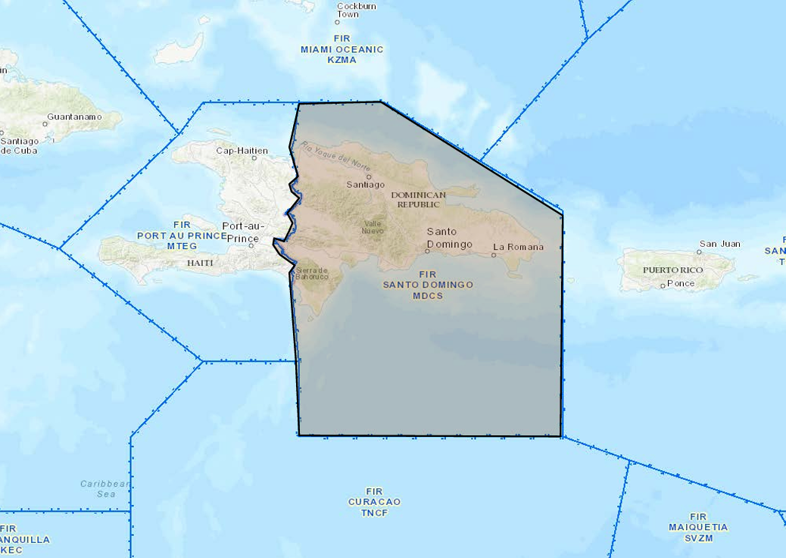
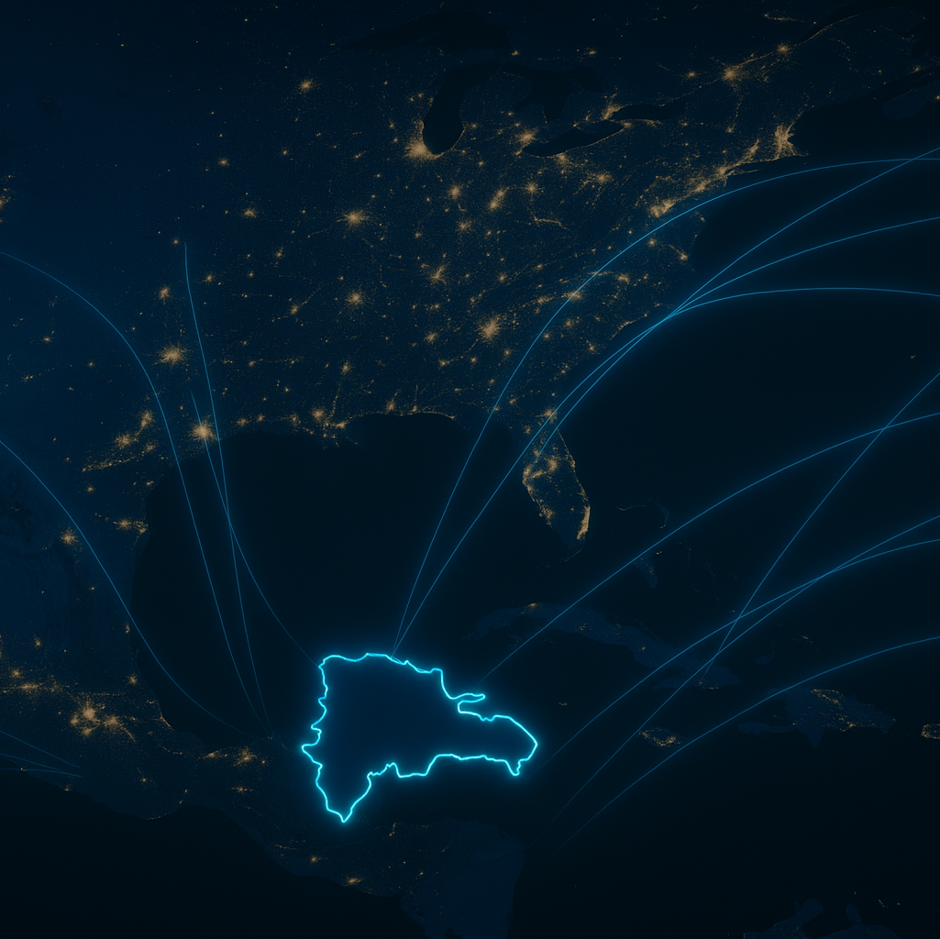
How is the Dominican Republic connected with other countries in the ATSEP context?
AARM 2025
Dominican Republic Participation
Notes:
Good Morning It is an honor for us to present the role, progress, and challenges of the ATSEP technical personnel of the Dominican Republic within the framework of AARM 2025. This presentation highlights how our country is connected and regionally integrated in air traffic management, and how our specialized personnel have contributed to improving operational safety standards, technological interoperability, and the efficiency of CNS/ATM services.
Through bilateral and multilateral agreements, and thanks to the active participation of our technicians, we have strengthened infrastructure, cybersecurity, and contingency management in the region. We also share the best practices adopted and the cooperation opportunities that continue to position the Dominican Republic as a key player in the international air navigation system.

Slide 2
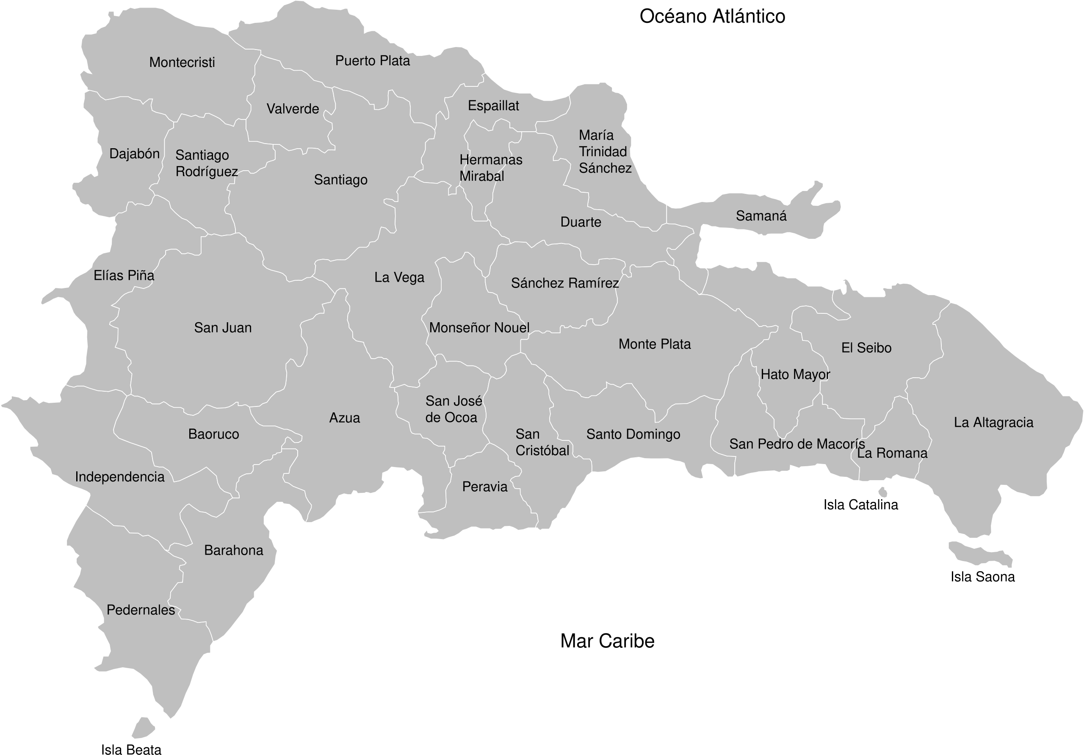
DOMINICAN AIRSPACE
OVERVIEW
Santo Domingo
FIR
VOR/DME
1
Notes:
The Dominican Republic manages its airspace through the Santo Domingo FIR (Flight Information Region). It includes 8 international airports and more than 6 national airports. The map also shows some radio navigation aids (like VOR and DME) used to support air traffic. This airspace plays a key role in connecting the Caribbean region with North, Central, and South America.
La República Dominicana cuenta con:
Aeropuertos internacionales (8):
Aeropuerto Internacional Las Américas (AILA) – Santo Domingo
Aeropuerto Internacional del Cibao – Santiago
Aeropuerto Internacional de Punta Cana
Aeropuerto Internacional Gregorio Luperón – Puerto Plata
Aeropuerto Internacional La Romana
Aeropuerto Internacional El Catey – Samaná
Aeropuerto Internacional María Montez – Barahona
Aeropuerto Internacional Joaquín Balaguer – El Higüero, Santo Domingo Norte
Aeródromos domésticos y privados (más de 6):
Incluyen aeródromos como:
Constanza
Cabo Rojo
Dajabón
San Juan de la Maguana
Monte Cristi
Aeródromos privados como Casa de Campo (La Romana), Cap Cana, entre otros.

Slide 3
Terminal Maneuvering Area (Terminal Control Area)
TMA
Cibao
TMA
Punta Cana
TMA
Santo Domingo
2
Notes:
The Cibao, Santo Domingo, and Punta Cana TMAs are now being introduced, designed to organize air traffic in the vicinity of the country's busiest airports. Technical support for the systems installed in these areas is essential to ensure the continuity of the ATS service.
We have communication equipment in the TMA of Santo Domingo to make possible the Radio communication it’s the TMA of Punta Cana and Cibao gdown.
In civil aviation, a TMA stands for "Terminal Control Area."
It is a controlled airspace surrounding one or more major airports. Its main function is to safely and orderly manage arrival and departure air traffic in the terminal region, that is, when aircraft are climbing after takeoff or descending for landing.
Key characteristics of a TMA:
It is located above the control areas (CTR).
It is managed by the air traffic control (ATC) service.
It has defined vertical and horizontal boundaries, adapted to traffic and geography.
Improves the efficiency and safety of air traffic in high-density areas.

Slide 4
North Sector
South Sector
3
Notes:
The FIR It is divided into two sectors: North and South. Their main function is to organize, coordinate, and control aircraft air traffic in these areas.
In a FIR (Flight Information Region), a sector is a subdivision of airspace used to manage air traffic more efficiently.
Definition of a sector in an FIR:
A sector is a block of airspace within an FIR assigned to a controller or team of air traffic controllers, for the purposes of:
Controlling aircraft in transit, arrival, or departure.
Dividing the workload into more manageable areas.
Improving the safety and efficiency of the control service.
Characteristics:
It can be horizontal (by geographic area) or vertical (by altitude).
It has defined boundaries (latitude, longitude, and flight levels).
Sectors can be opened or closed depending on traffic density.

Slide 5
Miami (Estados Unidos)
Puerto Príncipe (Haití)
Regional conection
San Juan (Puerto Rico)
Curazao
4
Notes:
The Dominican Republic, through the Santo Domingo FIR, maintains direct connections with the FIRs of Miami (United States), San Juan (Puerto Rico), Curaçao, and Port-au-Prince (Haiti). These connections allow for efficient and safe air traffic between various regions, thanks to established routes and coordination and data-sharing agreements.

Slide 6
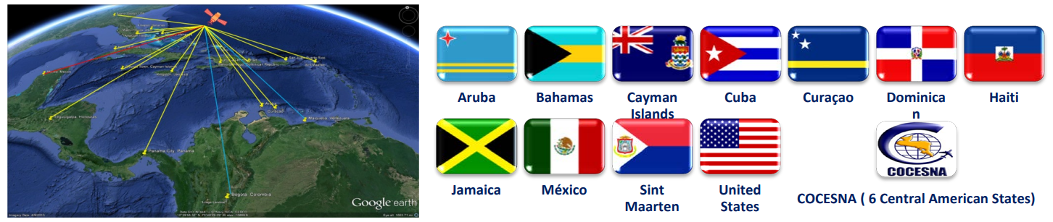
CONNECTIONS
SUSTAINED AGREEMENTS
Letter agreement between states.
Multilateral agreement promoted by ICAO and regional groups.
The ICAO regional agreement for operation of MEVA III and REDDIG II communication networks.
5
Notes:
The Dominican Republic is connected to regional communication networks through MEVA III and some service providers (ISP).

Slide 7
¿What services does it share?
Voice communication
Aeronautical information
Data radar
(In future project)
These coordination allow for:
Aircraft transfer between FIRs via voice coordination.
Exchange of flight plans and aeronautical messages.
Mutual support in the event of contingencies.
6
Notes:
The Dominican Republic maintains voice communications and aeronautical information exchange with the United States and other neighboring states. Radar data is shared with the United States, and implementation is underway to share it with Curaçao. Additionally, the AIDC service is available for automatic coordination between the FIRs of Santo Domingo, Miami, and San Juan.

Slide 8
BENEFITS TO THE COUNTRY FROM THE CONNECTION
Greater operational safety.
Greater efficiency in air traffic management.
More reliable and modern navigation services.
Integration with the global aviation system.
Strengthening the country's strategic positioning.
7
Notes:
What benefits does the country gain from this connection?
Improved air traffic safety and efficiency.
More modern and reliable navigation services.
Better integration into the global aviation system.
Stronger strategic positioning for the country in the region.

Slide 9

MAIN TECHNICAL CHALLENGES
🔗 Interoperability between systems and platforms
🔧 Technological updates
🛡️ Cybersecurity
👷‍♂️ Specialized personnel
8
Notes:
What technical challenges do we face in maintaining these connections?
Among the main technical challenges in maintaining international connections are:
Ensuring interoperability between different systems and platforms.
Constantly updating technology to comply with international standards.
Protecting infrastructure from cyber threats.
Maintaining specialized technical personnel in each area of ​​the system.
Maintaining operational connection nodes with each state that is part of the network.

Slide 10
How do we prepare for possible failures?
9
Collaboration in networks.
Participation in regional forums and networks. REDDIG II.
Information exchange. Automated and constant coordination (AIDC).
MEASURES TAKEN:
Updated contingency plans
Redundancy
Alternative connection systems.
REGIONAL COLLABORATION
Notes:
Measures taken:
We have updated contingency plans.
We use backup systems (redundancies).
We rely on alternate connections in case of failure.
Regional collaboration:
We take part in meetings and forums with other countries.
We share information and maintain constant coordination.

Slide 11

KEY LESSONS FROM PAST FAILURES
✅ Documentation of failures.
🔄 Implementation of redundancy to maintain continuous operation.
🧱 Implementation of robust infrastructure minimizes failures.
10
Notes:
What lessons have we learned from past failures?
We have learned key lessons from past failures, including:
The importance of having clear and up-to-date contingency protocols.
The need to diversify communication channels to ensure redundancy.
The value of ongoing training for ATSEP personnel for a timely technical response.
Each state must strengthen its infrastructure to minimize the impact of loss of services and avoid delays or congestion in air traffic.

Slide 12
TECHNOLOGICAL CHANGE MANAGEMENT: AFTN → AMHS
Technical training.
Specific training for ATSEP personnel.
Completion of the process and commissioning
Gradual implementation. Phased adaptation to ensure continuity.
Coordination with the FAA.
Parallel 4-month trial.
AFTN and AMHS operated together until stability was confirmed.
11
Notes:
How are technological changes (such as moving from AFTN to AMHS) handled?
The acronyms AFTN and AMHS refer to essential communication systems in international civil aviation, used for the exchange of messages between ground stations. Their definitions and differences are detailed below:
AFTN – Aeronautical Fixed Telecommunication Network
The AFTN is a worldwide network of aeronautical fixed circuits that is part of the Aeronautical Fixed Service (AFS). Its purpose is to facilitate the exchange of digital messages and data between aeronautical fixed stations with compatible communication characteristics. This network has been instrumental in the transmission of critical information for flight operations, including: (Skybrary)
Distress and urgency messages
Safety of flight messages
Weather data
Flight plans
Aeronautical administrative messages (Copperchase Ltd)
Originally, the AFTN used teletypewriter and radioteletypewriter links, later evolving to X.25 links. However, due to its capacity and speed limitations, it has been progressively replaced by more modern systems such as AMHS.
AMHS – Aeronautical Message Handling System
AMHS is an advanced digital system designed to replace the AFTN. Based on the X.400 profiles defined by the International Civil Aviation Organization (ICAO), AMHS enables the efficient and secure exchange of aeronautical messages, such as:
NOTAMs (Notices to Airmen)
Flight plans
Meteorological data
Air Traffic Services messages (LinkedIn)
AMHS offers two levels of service: (EUROCONTROL)
Basic: Provides similar functionality to the AFTN, ensuring interoperability during the transition.
Extended: Includes advanced capabilities such as binary information transfer, standard message headers, and support for online directories and digitally signed messages. (EUROCONTROL)

Slide 13
PARTICIPATION OF DOMINICAN ATSEPS AND SHARED GOOD PRACTICES
Interoperability projects with neighboring FIRs.
Technical exchange and best practices.
Execution of letters of agreement between states.
Standardized technical procedures.
Participation in the design and installation of CNS systems.
12
Notes:
How do Dominican ATSEPs participate in regional exercises or projects?
What best practices have we developed that other countries could copy?

Slide 14
By applying CPDLC and ADS-C technologies regionally to improve surveillance.
By developing joint cybersecurity projects.
By sharing training networks and technical resources.
How can we strengthen regional cooperation in aviation?
By using SWIM platforms to exchange real-time data.
13
Notes:
What new opportunities are there to improve cooperation and joint work?
There are several opportunities to strengthen cooperation and joint work in the region, including:
Adoption of SWIM platforms, which enable the efficient exchange of aeronautical information in real time.
Regional implementation of technologies such as CPDLC and ADS-C, which improve communication and surveillance in remote areas.
Development of joint cybersecurity projects to address common threats in a coordinated manner.
Creation of shared training and technical resource networks, which optimize the use of available knowledge and infrastructure.
Design and delivery of specialized courses at our academy, aimed at technical personnel in the region, promoting joint training and capacity building.

Slide 15
Measures in accordance with ICAO standards.
Regular audits and vulnerability testing.
Access control and network segmentation.
Ongoing cybersecurity training for ATSEP personnel.
Cybersecurity: Protection and Resilience
14
Notes:
How do we protect networks from threats such as cyberattacks?
Protecting our networks from cyberthreats is based on a preventative and controlled approach that includes:
Application of cybersecurity measures in accordance with ICAO guidelines.
Regular audits and vulnerability tests to detect and correct risks.
Strict access control and network segmentation, limiting potential impacts.
Ongoing cybersecurity training for ATSEP personnel.
Participation in national and international cybersecurity seminars.
In addition, we ensure that aeronautical networks remain closed and separate from the internet, using proprietary infrastructure, such as fiber optics or dedicated satellite links, to ensure their integrity and availability.

Slide 16



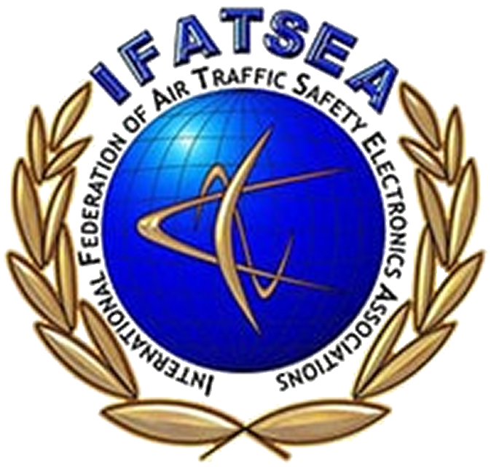
Juan Tomas S. Ing.
Presidente ADTEMA juan.silverio@idac.gov.do
Angel Bouret, Ing.
Sec. de asuntos Internacionales
angel.bouret@idac.gov.do
ADTEMA
Notes:
In Conclusion
The ATSEP personnel of the Dominican Republic are essential to maintaining safe, efficient, and modern air navigation services. Through regional cooperation, international agreements, and advanced technology, we have improved our operational capacity and aligned with global standards.
We actively participate in projects with other countries, upgrade our infrastructure, and learn from past experiences to strengthen our systems. This makes us a reliable partner in the international CNS/ATM environment.
We reaffirm our commitment to operational excellence, innovation, and teamwork to face the future challenges of aviation.
Thank you for your attention.

