Slide 1

Single European Sky (SES)
Single European Sky – overview and networking

Slide 2

Single European Sky (SES)
What is SES?
EU initiative to reform European airspace
Objective: standardization, safety, efficiency and environmental friendliness in air traffic
What is SESAR?
Technological pillar of SES
Objective: Research, development and implementation of new ATM technologies
© GdF – Gewerkschaft der Flugsicherung e. V. / Fachbereich FSTD / A. Vöcking. Thomas Schuster

Slide 3
Single European Sky (SES)
The following ANSPs are part of the SES performance scheme:
AA – Ireland
LFV – Sweden
LGS – Latvia
LPS – Slovakia
LVNL – Netherlands
MATS – Malta
MUAC – Maastricht Upper Area Control (multinational)
NATS (Continental) – United Kingdom
NAV Portugal (FIR Lisboa) – Portugal
NAVIAIR – Denmark
Oro Navigacija – Lithuania
PANSA – Poland
ROMATSA – Romania
Skyguide – Switzerland
Slovenia Control – Slowenien
Aena – Spain
ANA LUX – Luxembourg
ANS CR – Czech Republic
Austro Control – Austria
Avinor – Norway
Belgocontrol – Belgium
BULATSA – Bulgaria
DCAC Cyprus – Zypern
DFS – Germany
DSNA – France
EANS – Estonia
ENAV – Italy
Finavia – Finland
HCAA – Greece
HungaroControl – Hungary
© GdF – Gewerkschaft der Flugsicherung e. V. / Fachbereich FSTD / A. Vöcking. Thomas Schuster

Slide 4
Single European Sky (SES)
Functional Airspace Blocks (FABs)
Objective:
Unbundling airspace from national borders and organise airspace according to traffic flows
Increased efficiency through:
Fewer delays
Shorter flight routes
Lower fuel consumption
Increased safety and capacity
© GdF – Gewerkschaft der Flugsicherung e. V. / Fachbereich FSTD / A. Vöcking. Thomas Schuster

Slide 5

Single European Sky (SES)
FABEC – Belgium, Germany, France, Luxembourg, Netherlands, Switzerland
FAB CE – Austria, Slovenia, Czech Republic, Slovakia, Hungary, Croatia, Bosnia-Herzegovina
UK-Ireland FAB – United Kingdom, Ireland
NEFAB – Norway, Estonia, Finland, Latvia, Iceland
BALTIC FAB – Poland, Lithuania
DANUBE FAB – Romania, Bulgaria
BLUE MED FAB – Italy, Greece, Cyprus, Malta
(with the participation of Egypt, Tunisia, Albania, Jordan)
SW FAB – Spain, Portugal
© GdF – Gewerkschaft der Flugsicherung e. V. / Fachbereich FSTD / A. Vöcking. Thomas Schuster

Slide 6
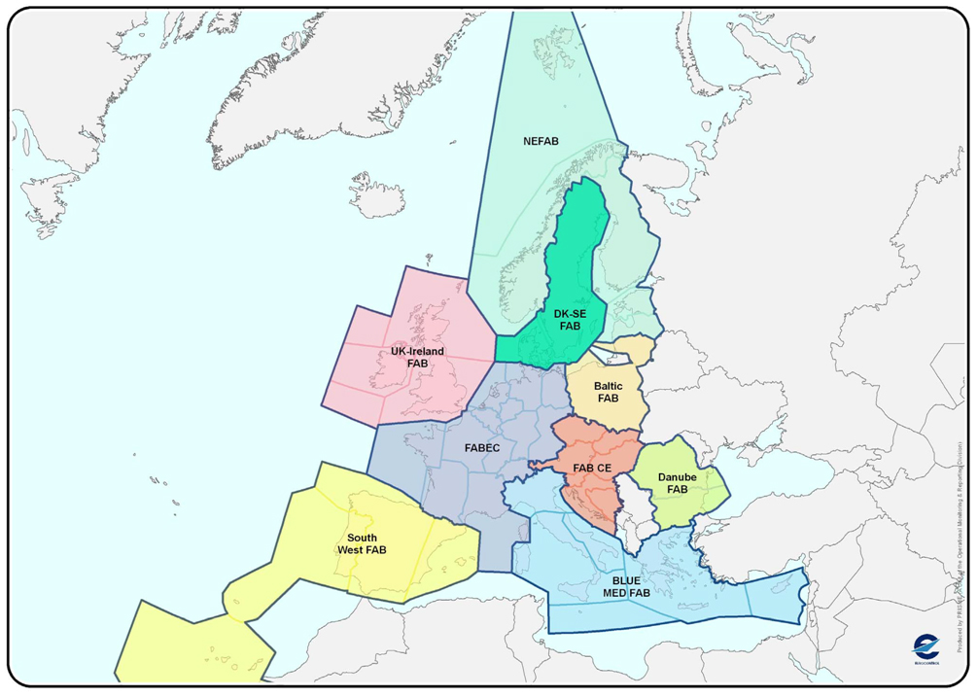
Single European Sky (SES)
© GdF – Gewerkschaft der Flugsicherung e. V. / Fachbereich FSTD / A. Vöcking. Thomas Schuster

Slide 7
Single European Sky (SES)
Background of SES/SESAR
Problem:
Nationally fragmented airspace with many control zones
Frequent handovers between air traffic control zones
Inefficient, delays, higher CO₂ emissions
Goal:
Single and coordinated European sky
Efficient, safe, environment friendly air traffic
© GdF – Gewerkschaft der Flugsicherung e. V. / Fachbereich FSTD / A. Vöcking. Thomas Schuster

Slide 8
Single European Sky (SES)
Objectives and measures of SES
Single European Sky by:
Transboundary Airspace Blocks (FABs)
Common technological standards and systems
Coordination of civil and military use
Improvement of safety, efficiency and environmental protection
© GdF – Gewerkschaft der Flugsicherung e. V. / Fachbereich FSTD / A. Vöcking. Thomas Schuster

Slide 9

Single European Sky (SES)
EUROCONTROL and technical networking
EU-wide coordination through:
Network Manager Operations Centre in Brussels
Coordination of flight schedules and traffic flows
Crisis management and traffic optimisation
© GdF – Gewerkschaft der Flugsicherung e. V. / Fachbereich FSTD / A. Vöcking. Thomas Schuster

Slide 10
Technology and airspace blocks
SESAR (Single European Sky ATM Research Programme)
Objectives:
Improving the safety and efficiency of air traffic by developing and introducing new technologies and processes
Development of a state-of-the-art ATM system for all shareholders
Three phases:
Definition: Needs assessment
Development: Prototypes & technologies
Deployment: Implementation in practice
Examples:
SWIM (System Wide Information Management)
iTEC
COOPANS
Virtual center concepts
Automation & AI in air traffic management
© GdF – Gewerkschaft der Flugsicherung e. V. / Fachbereich FSTD / A. Vöcking. Thomas Schuster

Slide 11
Technology and airspace blocks
Importance of SES/SESAR for ATSEP
Technological change:
new systems require new skills
e.g. IP-based communication, cyber security, remote towers
Increased complexity:
Integration of heterogeneous systems (legacy & modern)
More interoperability & networking (SWIM, DataLink etc.)
Continuous training necessary
ICAO requirements, EU regulations, EASA guidelines (e.g. VO (EU) 2017/373)
© GdF – Gewerkschaft der Flugsicherung e. V. / Fachbereich FSTD / A. Vöcking. Thomas Schuster

Slide 12
Technology and airspace blocks
Challenges for ATSEP
Dealing with high system availability & safety relevance
Changing roles: from reactive technician to proactive system integrator
Coordination with international partners (single airspace)
Participation in implementation processes (SESAR Deployment Manager)
Opportunities for ATSEP
Expansion of technical expertise & specialist knowledge
Participation in international high-tech innovation
Helping to shape the future of ATM
Professional development through specialization
© GdF – Gewerkschaft der Flugsicherung e. V. / Fachbereich FSTD / A. Vöcking. Thomas Schuster

Slide 13
conclusion
SES and SESAR are central pillars of future European ATC
ATSEPs play a key role in implementing safe, efficient and modern systems
Training, networking and commitment are crucial for a successful future in a changing ATM environment
EASA rulemaking is in progress (e.g. Regulation VO (EU) 2017/373)
SES not yet fully implemented
progress in the various FABs is very different
Strong coordination via EUROCONTROL and European Commisssion
Political hurdles due to national sovereignty
The goal: an efficient and safe European sky
© GdF – Gewerkschaft der Flugsicherung e. V. / Fachbereich FSTD / A. Vöcking. Thomas Schuster

Slide 14

Single European Sky (SES)
© GdF – Gewerkschaft der Flugsicherung e. V. / Fachbereich FSTD / A. Vöcking. Thomas Schuster

Slide 15
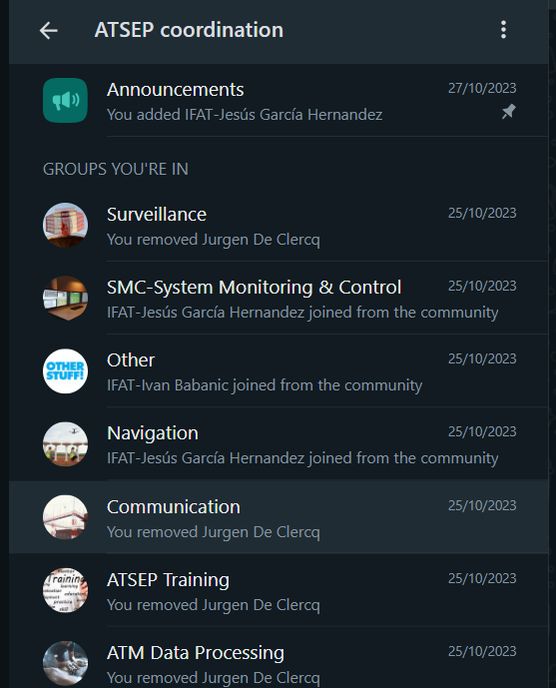
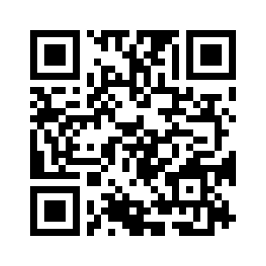
ATSEP Community
Welcome to the WhatsApp community to connect ATSEP professionals:
Rules of conduct:
This community is by and for ATSEP to coordinate on CNS/ATM related topics.
This group was established by the "Lessons Learned" working group from IFATSEA (Eurogroup).
Best practices:
🛫 Be efficient with your communication (better 1x large message, than 2x small ones)
🛫 Use emojis to react on messages instead of empty replies
🛫 Respect the topics of the different groups when posting messages
🛫 Use "Other" when none of the listed groups match your subject
🛫 Please use this forum only for professional and ATSEP related questions/communications.
🛫 This forum is only for ATSEP that are employed by ANSP and are part of IFATSEA
Join one or multiple groups inside the community via the QR code or link https://chat.whatsapp.com/HH7HakQHizFFSRIIJOU1O7
Please share inside your ANSP to connect to CNS & ATM ATSEP worldwide!
© GdF – Gewerkschaft der Flugsicherung e. V. / Fachbereich FSTD / A. Vöcking. Thomas Schuster

Slide 16
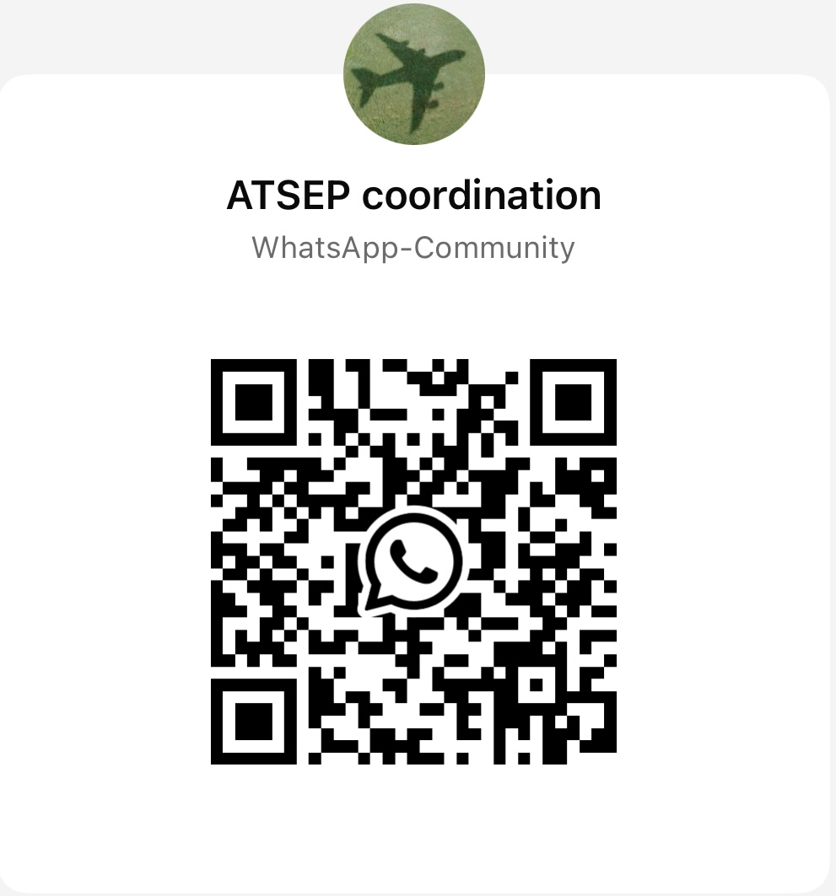
ATSEP Community

